Slide 1

CRJS 5240 02 CRIME MAPPING
Hanisha KARRI

Slide 2
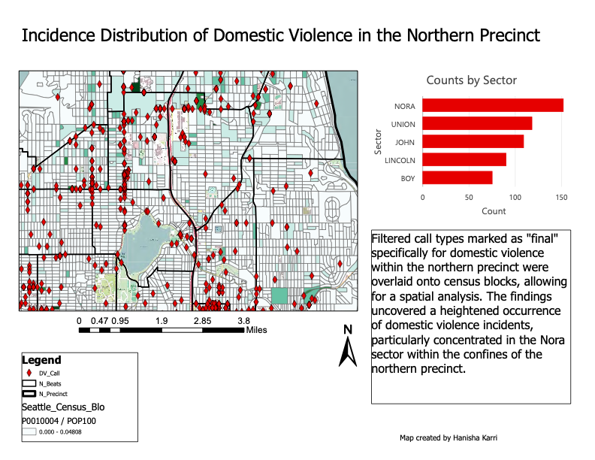
Map 1: incidence distribution of domestic violence

Slide 3
Map 2: geospatial examination of November incidents

Slide 4
Map 3: spatial analysis with kernel density hotspot map and contour

Slide 5
conclusion
Strategic Resource Allocation
Enhanced predictive Capabilities

Slide 6

HANISHA KARRI

